Slide 1
CacheBlend: RAG with Cached Knowledge Fusion
Hongmin Li
CacheBlend: Fast Large Language Model Serving for RAG with Cached Knowledge Fusion. EuroSys’24

Slide 2
Outline
Introduction
Introducing LLM
Inference with KV cache
Background & Challenges
The CacheBlend Solution
Idea
Implementation
Experimental Setup & Results

Slide 3
Outline
Introduction
Introducing LLM
Inference with KV cache
Background & Challenges
The CacheBlend Solution
Idea
Implementation
Experimental Setup & Results

Slide 4
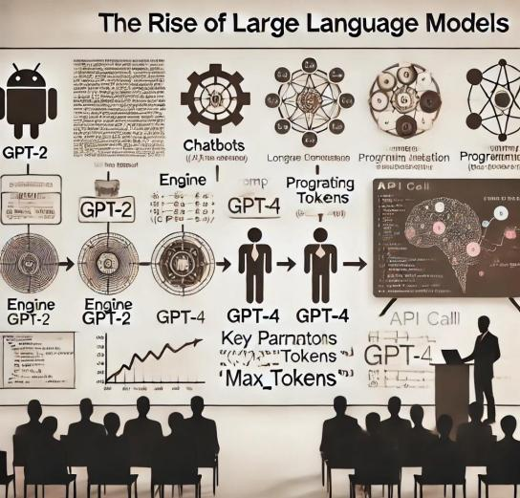
The Rise of Large Language Models (LLMs)
Advanced models trained to generate and manipulate human language.
GPT-2, GPT-3, GPT-4, Claude …
Popular Apps:
Chatbot
Content Creation
Code copilot
AI agents

Slide 5
Outline
Introduction
Introducing LLM
Inference with KV cache
Background & Challenges
The CacheBlend Solution
Idea
Implementation
Experimental Setup & Results

Slide 6
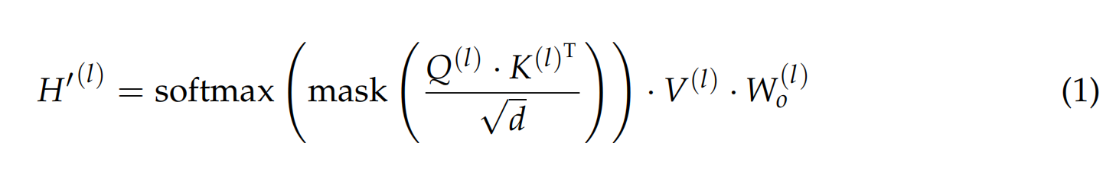
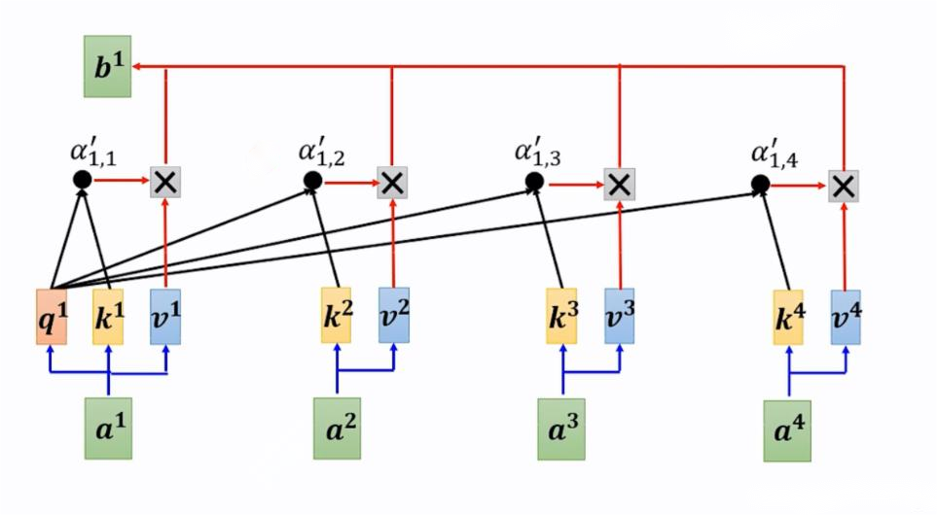
Basic steps of LLM Inference
A standard inference process without kv cache has O(n²) complexity

Slide 7
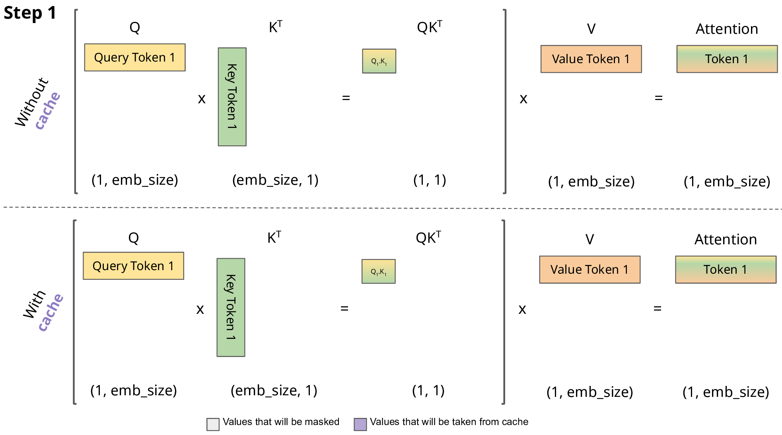
KV Cache in LLM Inference
Inference with KV cache VS without KV cache
Inference with KV cache has O(n) complexity!

Slide 8
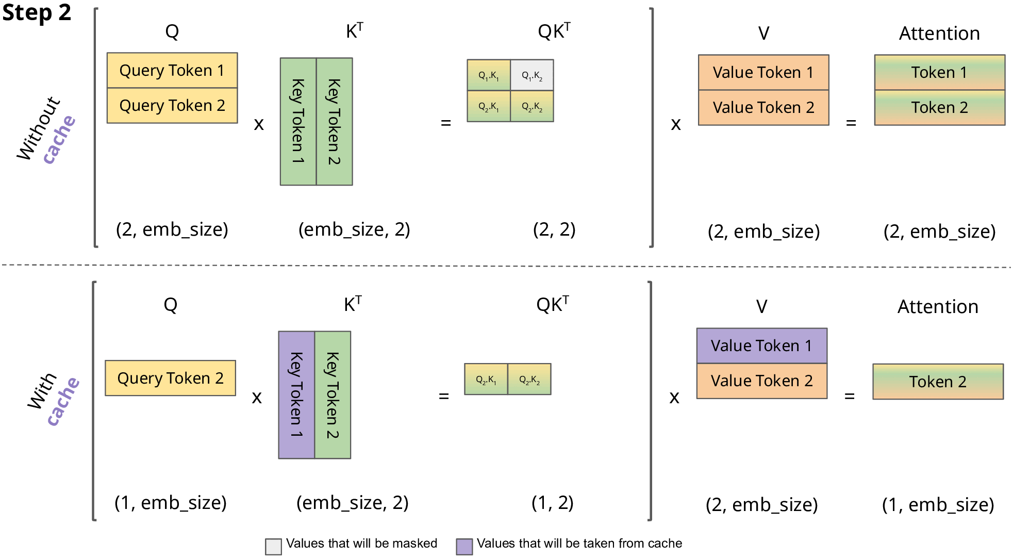
KV Cache in LLM Inference
Inference with KV cache VS without KV cache
Inference with KV cache has O(n) complexity!

Slide 9
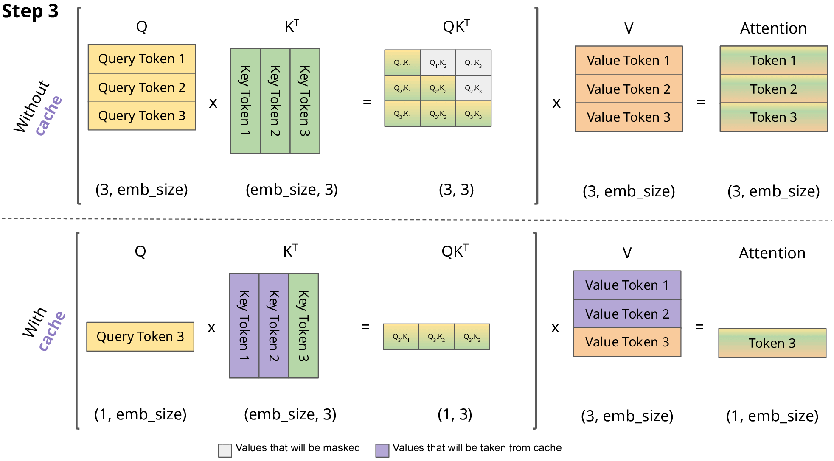
KV Cache in LLM Inference
Inference with KV cache VS without KV cache
Inference with KV cache has O(n) complexity!

Slide 10
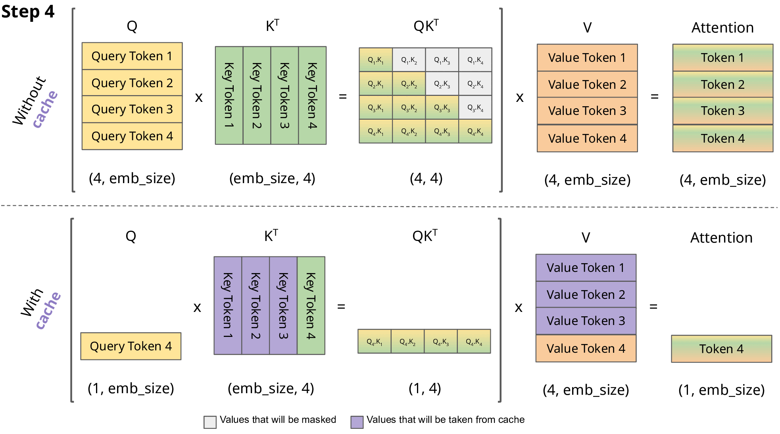
KV Cache in LLM Inference
Inference with KV cache VS without KV cache
Inference with KV cache has O(n) complexity!

Slide 11
Outline
Introduction
Introducing LLM
Inference with KV cache
Background & Challenges
The CacheBlend Solution
Idea
Implementation
Experimental Setup & Results

Slide 12
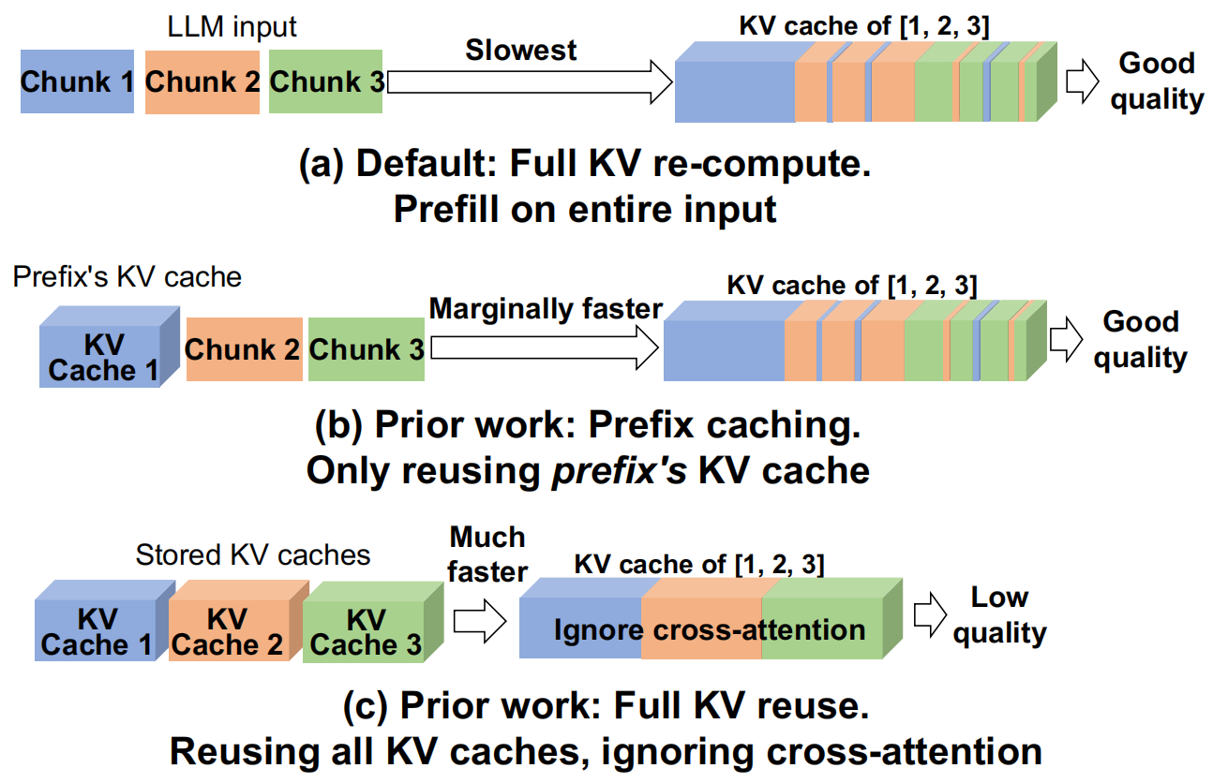
Limitations Under Long Inputs
Handling Multiple Text Chunks in Inputs
RAG uses prefix to enhance quality
Long input sequences
Contextual dependencies
Prefix Caching
Stores and reuses the KV cache of the prefix of the LLM input
Full KV Cache Reuse
Entire KV cache is reused for every text chunk by adjusting its positional embedding
Notes:
一般rag类的大模型会使用一些prefix信息提升回复的准确率和连续回复
这些prefix信息提供必要的领域知识或特定信息的用户上下文

Slide 13
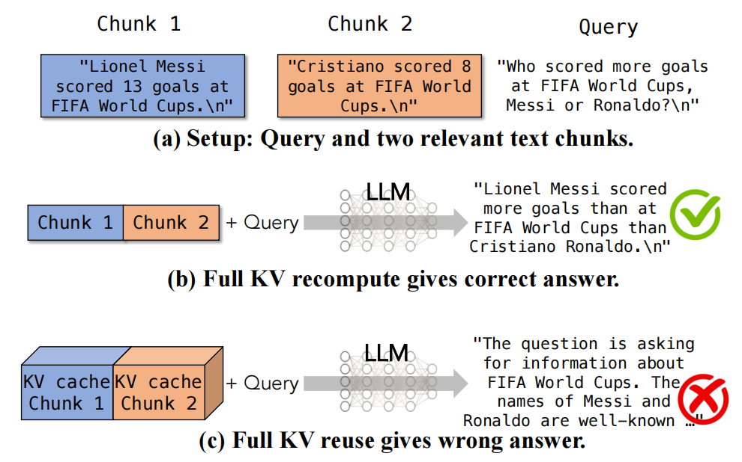
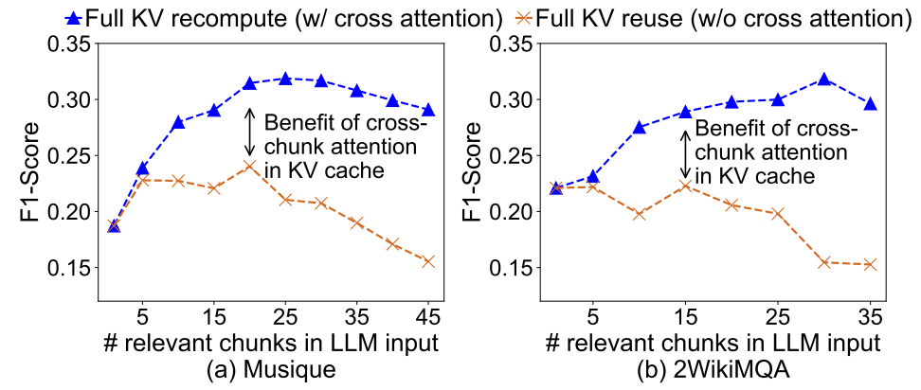
Reusing KV cache
Prefix Caching
Does not account for the cross-attention between different text chunks, leading to suboptimal performance
Limited benefits when multiple chunks are involved
Full KV Cache Reuse
Ignores Cross-Attention Between Chunks
The preceding text is not known when precomputing the KV cache
How to obtain both the speed of full KV reuse and the
generation quality of full KV recompute?

Slide 14
Outline
Introduction
Introducing LLM
Inference with KV cache
Background & Challenges
The CacheBlend Solution
Idea
Implementation
Experimental Setup & Results

Slide 15
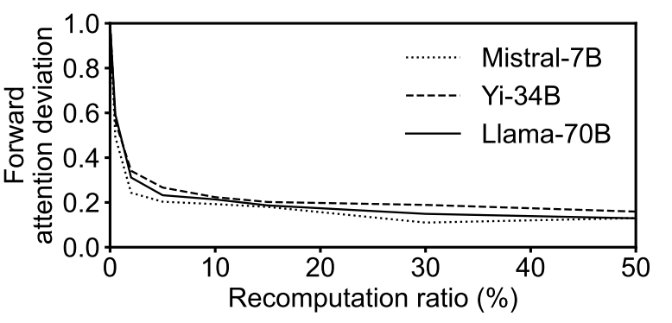
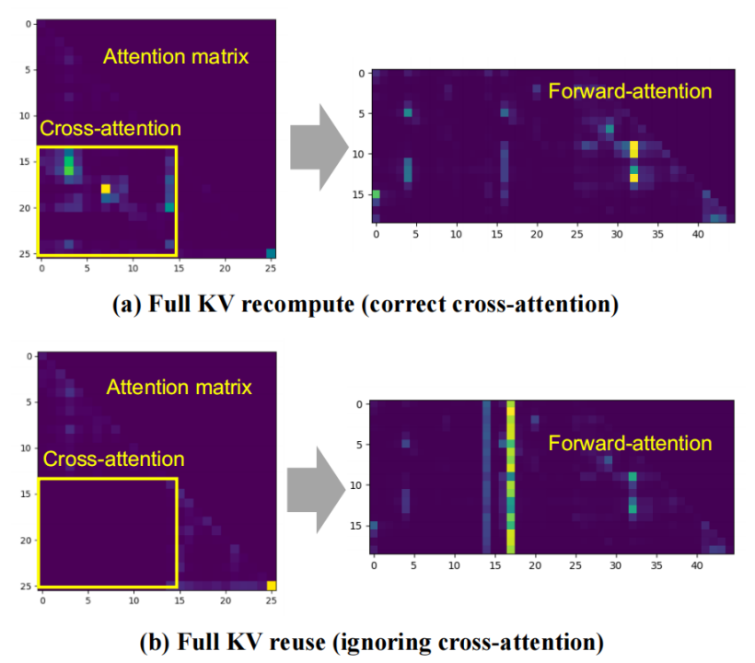
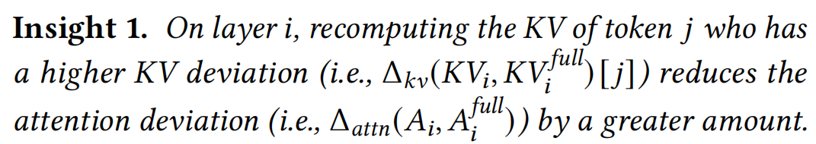
The CacheBlend Solution - Idea
Initial Computation
Compute KV caches for all tokens
Select which tokens to recalculate?
Attention deviation reduces as we recompute the KV of more tokens on each layer
Recompute only the
HKVD (High-KV-Deviation) tokens

Slide 16
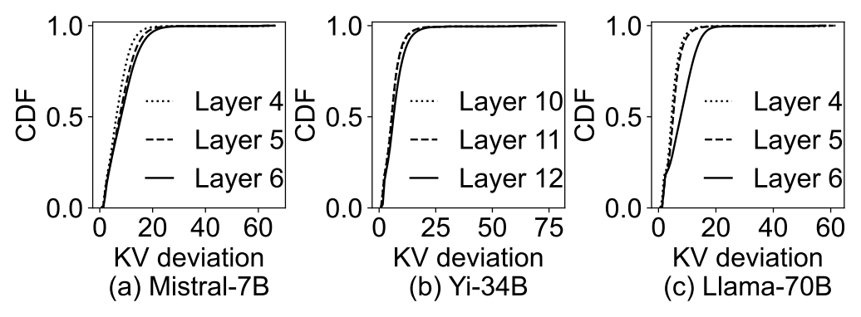
The CacheBlend Solution - Idea
Do we need to recompute KV for most tokens?
Choose 10-20% tokens as HKVD (High-KV-Deviation) tokens and recomputing their KV
Distribution of KV deviation of different tokens on one layer

Slide 17
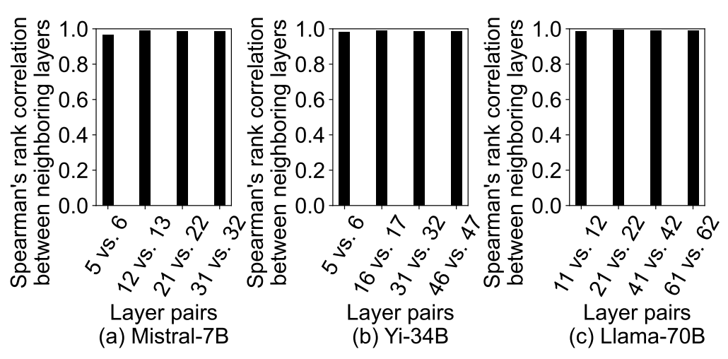
The CacheBlend Solution - Idea
How to select High-KV-deviation tokens without computing the full-prefilled KV cache?
Insight 2. Tokens with the highest KV deviations on one layer are likely to have the highest KV deviations on the next layer
Input embedding of each token changes
slowly between layers in transformer models
Rank correlation of the KV deviation per token between two consecutive layers

Slide 18
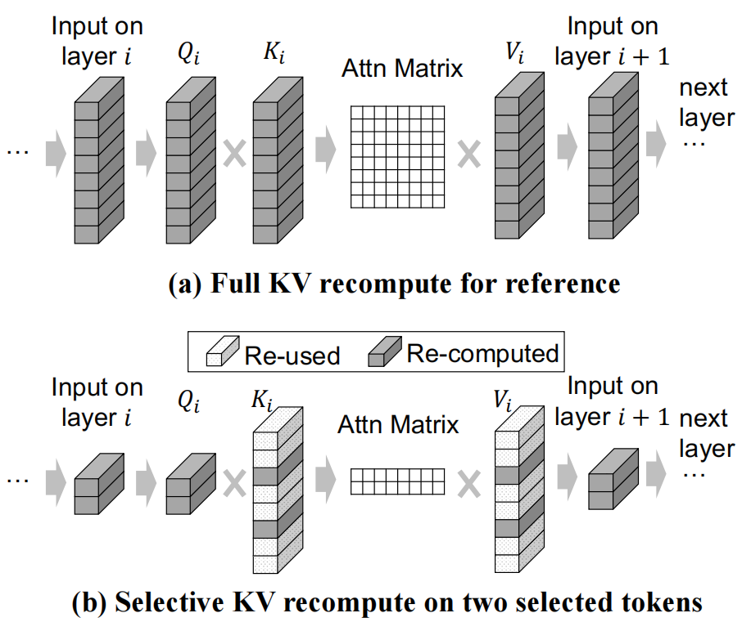
The CacheBlend Solution - Idea
Selectively Recomputing KV cache
Select the recomputed tokens
Transform the reduced input into Q, K and V
Expand the KV cache by reusing other unselected tokens
Produce the next layer
An LLM has over 30 layers.
How to implement in the real system?

Slide 19
Outline
Introduction
Introducing LLM
Inference with KV cache
Background & Challenges
The CacheBlend Solution
Idea
Implementation
Experimental Setup & Results

Slide 20
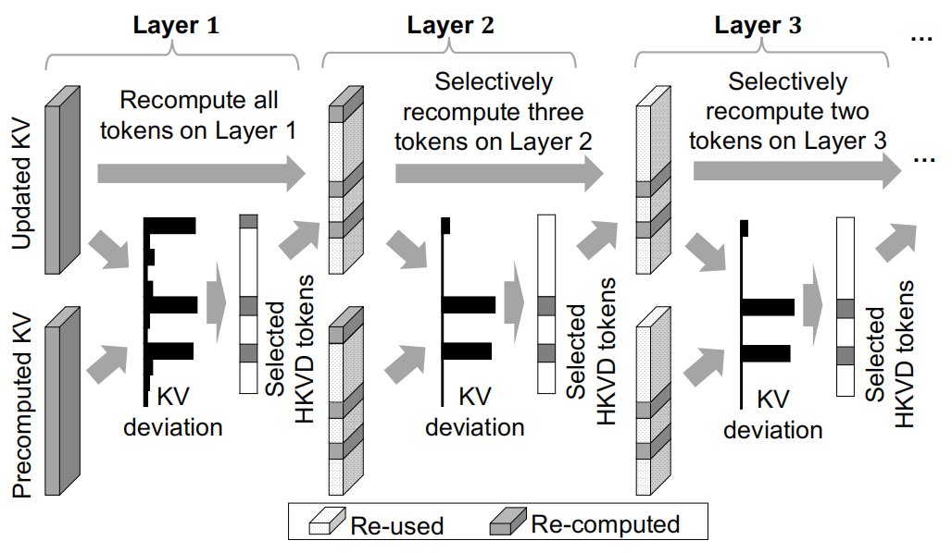
The CacheBlend Solution - Implementation
Gradual-Filtering Scheme for Selecting HKVD Tokens
Initial layer (First layer)
Compute and store KV caches for all tokens
Pick r₁% tokens based on attention deviation
Subsequent layer
Recompute KV of selected tokens and reuse other tokens
Pick r₂% (< r₁%) tokens with highest attention deviation
Continue for each layer, reducing the percentage of selected tokens
How to choose r based on devices,
or how to choose hardware to meet the r?

Slide 21
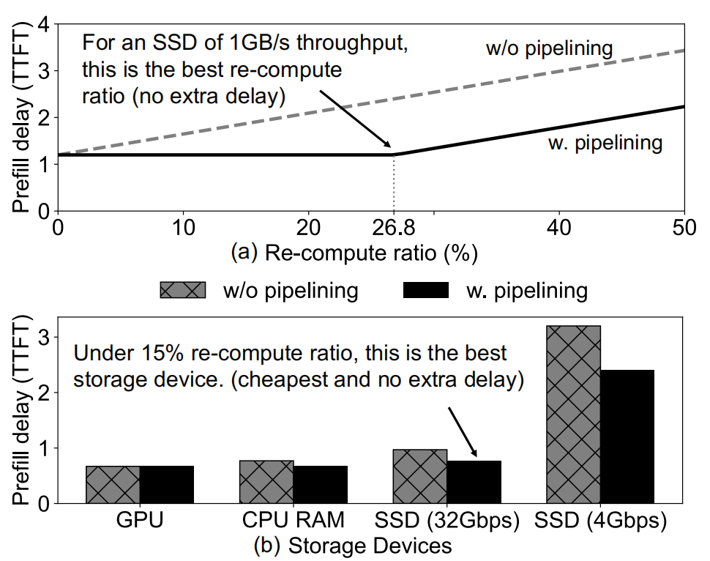
The CacheBlend Solution - Implementation
Pipelining KV loading and recompute
KV-loading delay should be able to hide the selective recompute delay
Organize KV loading and recomputation into a series of steps and use a load controller to manage resource allocation
Key components
Loading Controller
KV cache store
Fusor
Notes:
selective recompute of one layer can start immediately after pre-computed the KV cache of the previous layer is loaded into the GPU.

Slide 22
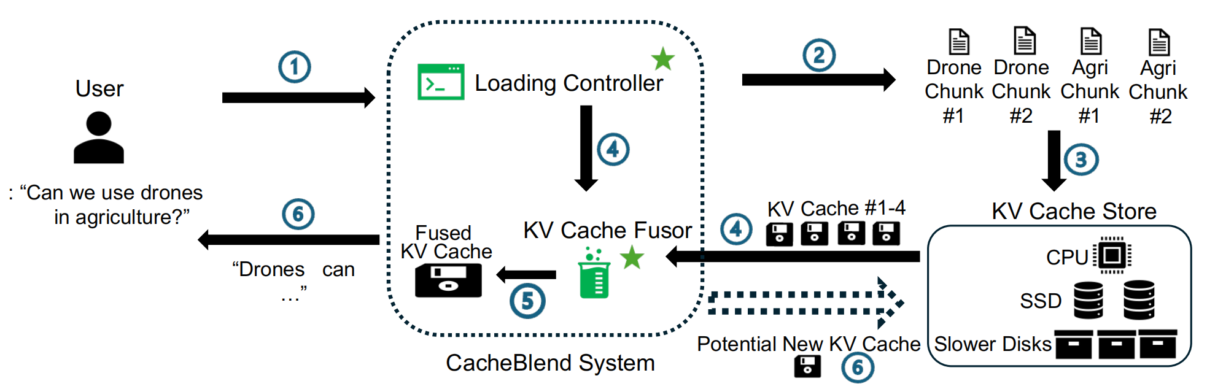

The CacheBlend Solution - Implementation
Load Controller
Dynamically adjust the amount of KV cache to store
Adjust the proportion of tokens to recompute based on system load
Recompute delay estimator
T_{recom}(r%, LLM, Load)=r%xPrefill(LLM,Load)
Loading delay estimator
T_{load}(LLM, Len, storage_device)
=$\frac{PerTokenKVSize(LLM)×Len}{Trgoughpput(Storage_device)}$

Slide 23
The CacheBlend Solution - Implementation
KV cache store
Split an LLM input into multiple text chunks, each of which can be reused
Each input chunk is hashed to find their corresponding KV cache
Evict least recently used KV caches
Fusor
Merge pre-computed KV caches via selective recompute
Mix recomputed previous layer and the loading KV caches

Slide 24
Outline
Introduction
Introducing LLM
Inference with KV cache
Background & Challenges
The CacheBlend Solution
Idea
Implementation
Experimental Setup & Results

Slide 25
Experimental Setup
Models
Mistral-7B, Yi-34B and Llama-70B
Hardware
128 GB RAM
2 Nvidia A40 GPUs
1 GPU to serve Mistral-7B and Yi-34B, and 2 GPUs to serve Llama-70B
1TB NVME SSD whose measured throughput is 4.8 GB/s
Datasets
2WikiMQA, Musique, SAMSum and MultiNews

Slide 26
Experimental Setup
Baselines
Full KV recompute
Calculate KV cache of all tokens during prefill
Prefix cache
Recompute KV cache of non-prefix tokens and reuse the frequently used prefix chunks
Full KV reuse
Reuse all the chunks
MapReduce
Summarises all chunks in parallel and concatenates them together to generate the input
MapRerank
Independently generates an answer from each chunk along with a score based on its confidence that the answer is correct

Slide 27
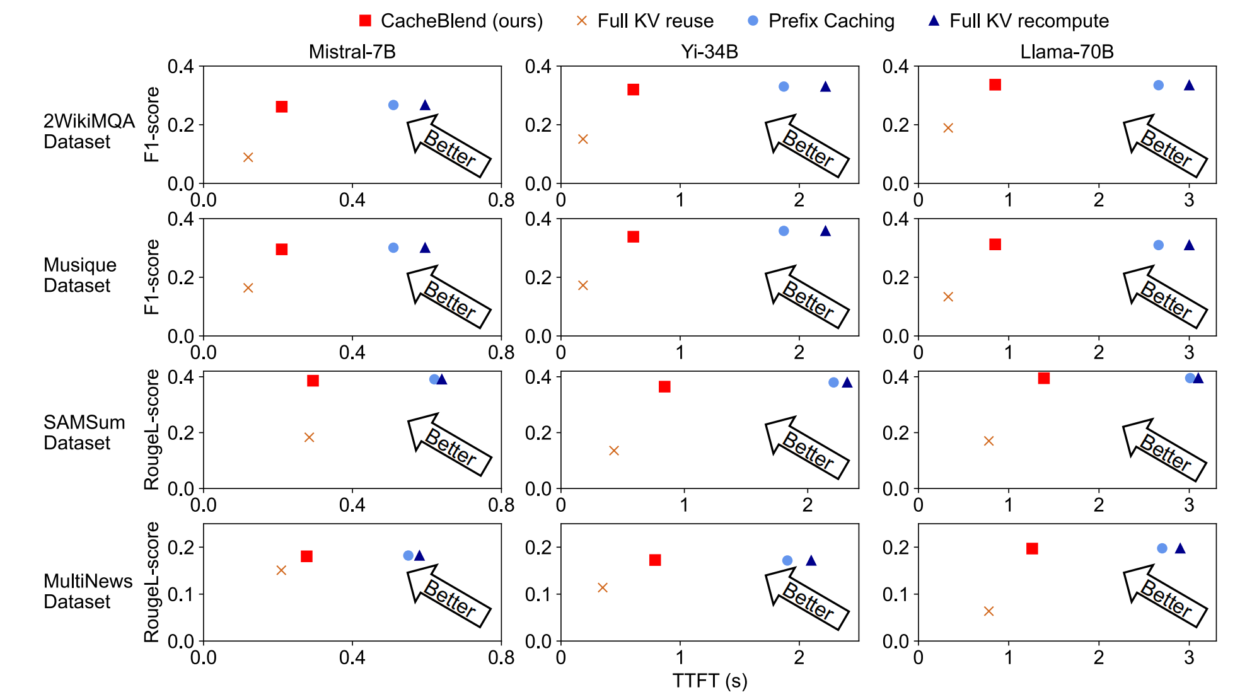
Experimental Results - Overall Imprevement
TTFT & Quality

Slide 28
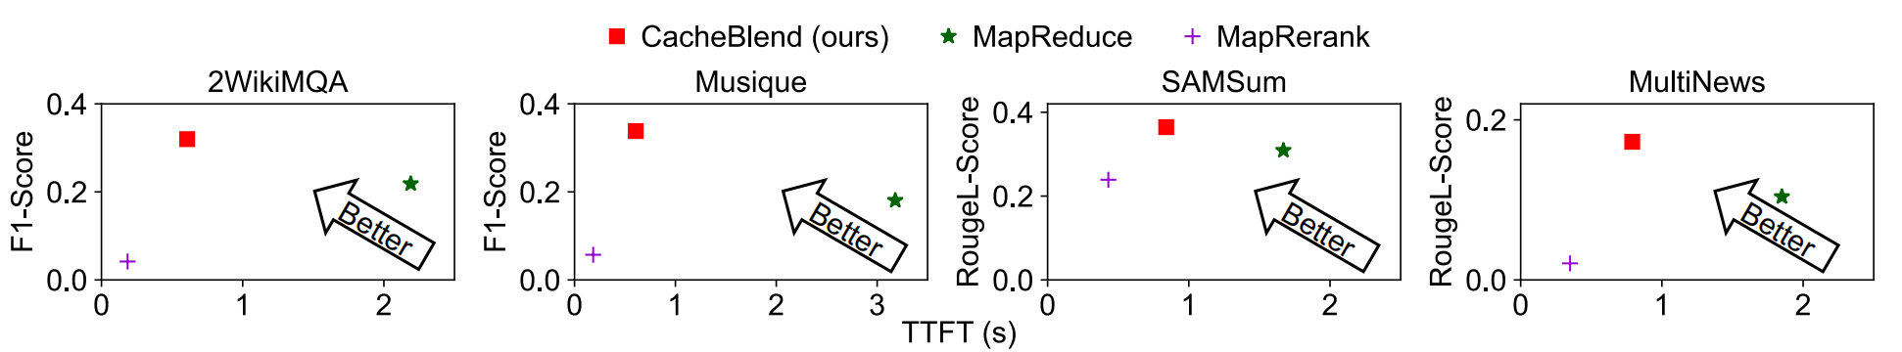
Experimental Results - Overall Imprevement
TTFT & Quality
CacheBlend obtains reduced TTFT with minimal quality drop

Slide 29
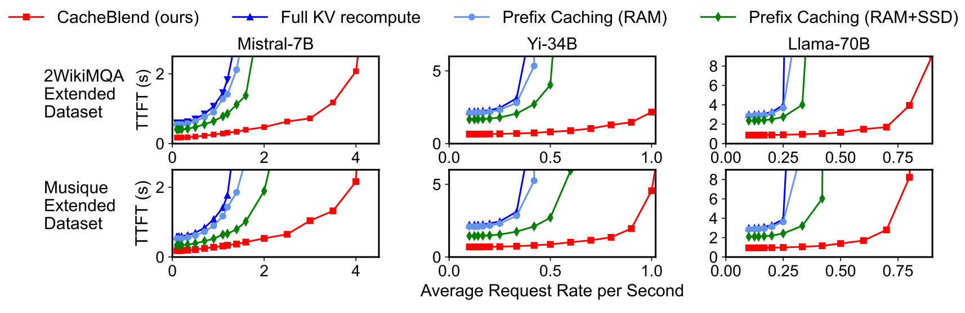
Experimental Results - Overall Imprevement
TTFT & Throughput
CacheBlend obtains higher throughput with lower delay

Slide 30
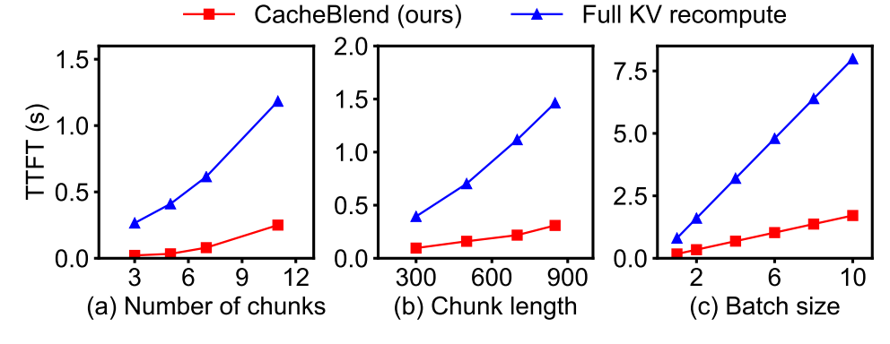
Experimental Results - Sensitivity Analysis
Varying chunk numbers and lengths
Compute time reduction ratio remains similar across different numbers of chunks and chunk length settings

Slide 31
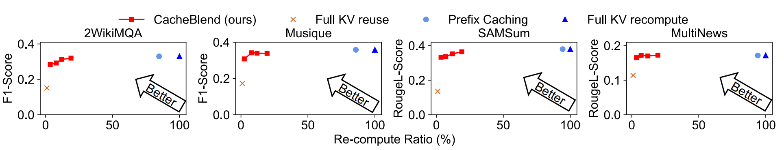
Experimental Results - Sensitivity Analysis
Varying recompute ratios
At most 0.002 loss in F1 score or Rouge-L score under 5%~18% recomputation ratio, while 3.4-6.6×TTFT reduction

Slide 32
End
Thank you for listening!
Q&A

